Slide 1

SoleMates

Slide 2
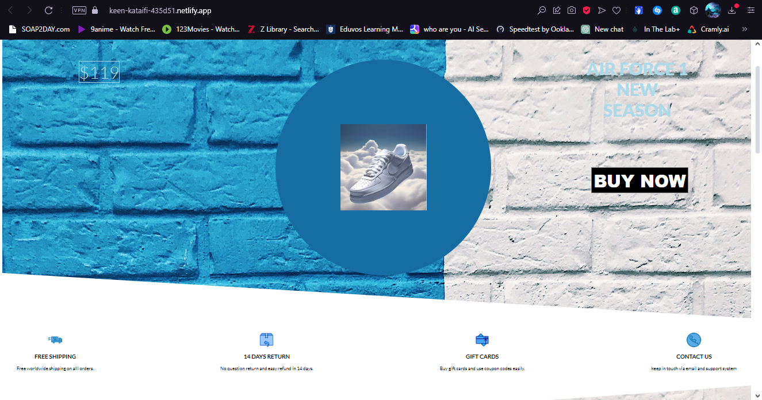
The SoleMates web application was created to help a local shop owner take his business online to reach more customers as well as to establish a trustworthy interaction and payment

Slide 3
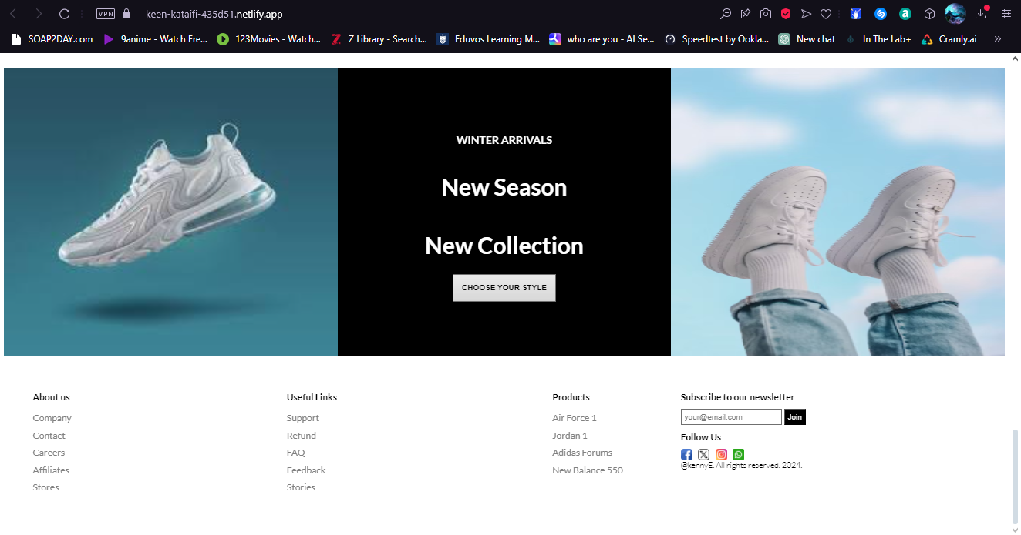
SoleMates is an ecommerce platform that sells lifestyle shoes

Slide 4
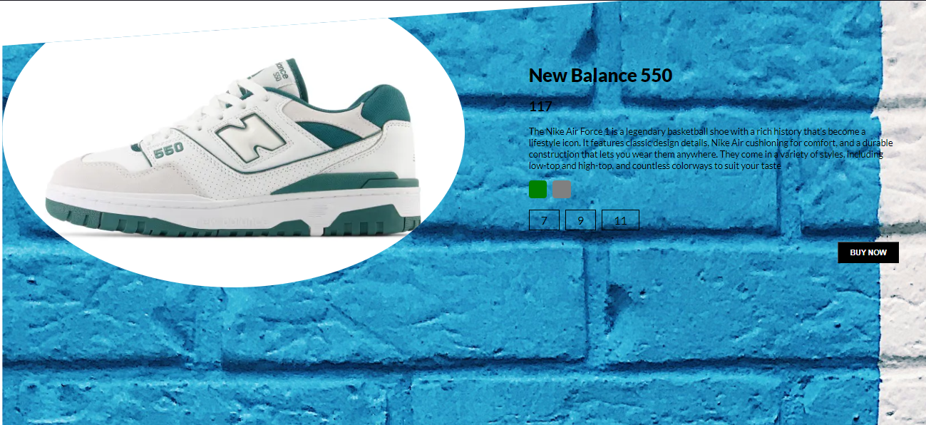
This is how you choose the product size and color before you proceed to the payment form

Slide 5
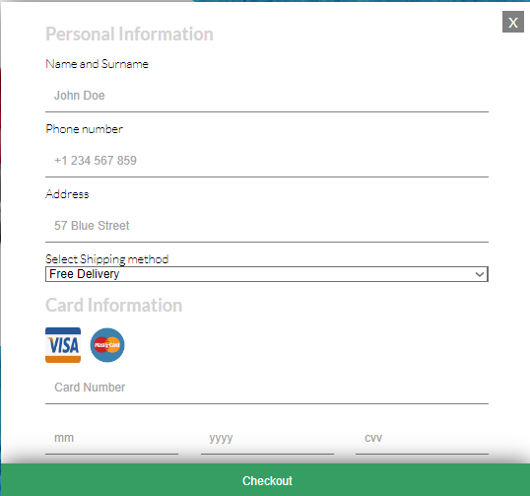
Payment form You can make use of either debit or credit cards to make the payments

Slide 6

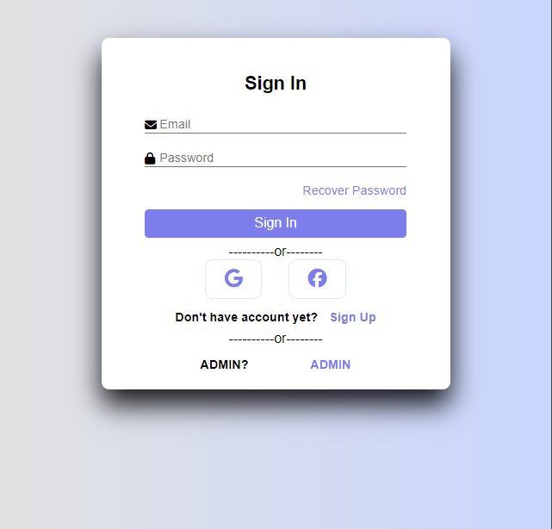
Login/Sign up

Slide 7
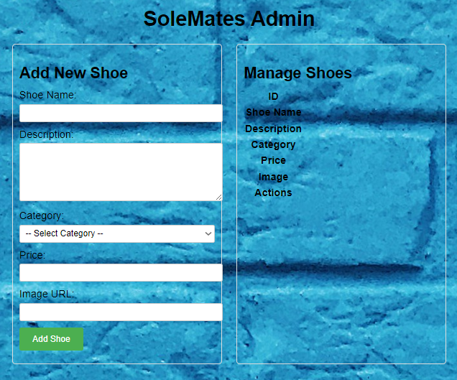
ADMIN Area

